Slide 1
Designing Secure Architectures Using Software Patterns Dr Md Sadek Ferdous
COMP6236 - Software Engineering and Cyber Security

Slide 2
Last week
Identify and mitigate security threats with STRIDE
Identify and mitigate privacy threats with LINDDUN

Slide 3
Today
Define Security Patterns
Example of Usage
Switch room!
Exercise on using Security Patterns (30 min)
Discussion of results (10 min)

Slide 4
Learning outcomes
By the end of this session you will be able to
Define what a security pattern is
Select patterns for securing your software architecture
Instantiate a pattern for your software architecture

Slide 5
Building Secure Architectures
Identify Threats
STRIDE
Plan Mitigation Strategy
STRIDE
Instantiate Strategy
SECURITY PATTERNS
LINDDUN
LINDDUN

Slide 6
What is a Security Pattern?
A security pattern describes a solution to control, stop or mitigating a set of specific threats through some security mechanisms defined in a given context
A security pattern describes
A single kind of security problem
The solution as a constructible software entity
Design steps or rules for constructing the solution

Slide 7
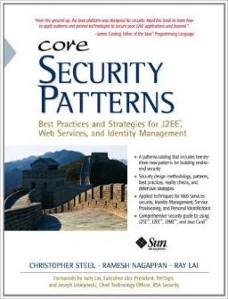
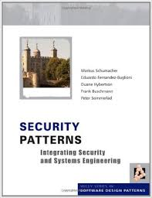
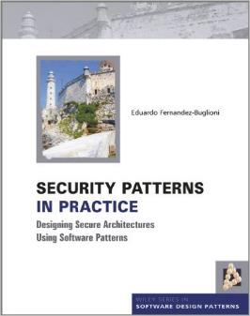
Security Patterns Catalogs
Schumacher et al., Security Patterns
Steel et al., Core Security Patterns
Fernandez, Security Patterns in Practice

Slide 8
Types of Security Patterns
Identity Management
Authentication
Access Control
Secure Process Management
Secure Execution and File Management
Secure OS Architecture and Administration
Networks
Web Services Security
220
Patterns

Slide 9
The Security Pattern Template
Standard way to describe a pattern
Helps to compare and apply patterns to your software architecture
Main Sections
Problem & Forces
Solution
Implementation
Consequences

Slide 10
The Security Pattern Template
Name
Should capture the essence of the pattern in a concise and catchy manner
Intent
Should summarize the pattern briefly in 2/3 sentences
Includes what the purpose or intent of the pattern
Aliases
Should enumerate other names for the patterns

Slide 11
The Security Patterns Template
Problem & Forces
Outlines the context in which the patterns is applicable, as well as explaining the motivation for using pattern
Solution
Should describe at a high level how the pattern solves the problem described in the problem statement
Static structure
Presents the constituent elements involved in the usage of this pattern
Dynamic structure
Describes interactions between the various components in the static structure

Slide 12
The Security Patterns Template
Implementation and Pitfalls
Guidance on implementing the pattern
Most common mistakes in the usage of this pattern and provide the reader with guidance for avoiding them
Consequences
Describe the possible impact of using the pattern with respect to CIAA, performance, cost, manageability, usability
Example and Known Uses
Explicit references to products or systems

Slide 13
An Example: Social Network
User
Portal
SN Service
Database
Spoofing of User
Login and Password
Login
OK
Solution:
Secure Pipe
Security Pattern
Update Profile
Forward Update
Store Updates

Slide 14
Name and Intent
Name: Secure Pipe
Intent: You need to provide privacy and prevent eavesdropping and tampering of client transactions caused by man-in-the- middle attacks
Notes:
Name: Should capture the essence of the pattern in a concise and catchy manner
Intent: Should summarize the pattern in 2/3 sentences
Includes what the purpose or intent of the pattern is
Doesn’t go into implementation details

Slide 15
Problem
Web-based transactions are often exposed to eavesdropping, replay, and spoofing attacks. Anytime a request goes over an insecure network, the data can be intercepted or exposed by unauthorized users. Even within the confines of a VPN, data is exposed at the endpoint, such as inside of an intranet. When exposed, it is subject to disclosure, modification, or duplication. Many of these types of attacks fall into the category of man-in-the-middle attacks. Replay attacks capture legitimate transactions, duplicate them, and resend them. Sniffer attacks just capture the information in the transactions for later usage.

Slide 16
Forces
You want to avoid writing application logic to provide the necessary protection; it is better to push this functionality down into the infrastructure layer to avoid complexity.
You want to make use of hardware devices that can speed up the cryptographic algorithms needed to prevent confidentiality-and integrity-related issues.
You want to adopt tested, third-party products for reliable data and communication security.
You want to limit the protection of data to only sensitive data due to the large processing overhead and subsequent delay due to encryption.

Slide 17
Solution
Use a Secure Pipe to guarantee the integrity and privacy of data sent over the wire. A Secure Pipe provides a simple and standardized way to protect data sent across a network. It does not require application-layer logic and therefore reduces the complexity of implementation. In some instances, the task of securing the pipe can actually be moved out of the application and even off of the hardware platform altogether. Because a Secure Pipe relies on encrypting and decrypting all of the data sent over it, there are performance issues to consider. A Secure Pipe allows developers to delegate processing to hardware accelerators, which are designed especially for the task.

Slide 18
Structure

Slide 19
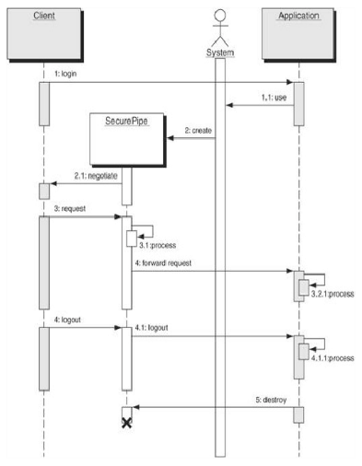
Dynamics
Notes:
Check the figure

Slide 20
Implementation
There are several strategies for implementing a Secure Pipe pattern, each with its own set of benefits and drawbacks. Those strategies include: web-server-based SSL/TLS, hardware-based cryptographic accelerator cards, application-layer encryption using the Java Cryptography Extension (JCE).
Look into the catalog for a description of each implementation strategy!!!

Slide 21
Pitfalls
The Secure Pipe pattern is an integral part of most Web server infrastructures because we make use of SSL/TLS between the client and the Web Server. Without it, mechanisms for ensuring data privacy and integrity must be performed in the application itself, leading to increased complexity, reduced manageability, and the inability to push the responsibility down into the infrastructure.
Infrastructure
Data Encryption Performance
Server Certificates

Slide 22
Consequences
Ensures data confidentiality and integrity during communication
Promotes interoperability
Improves performance
Reduces complexity
Look into the catalog for a description of each consequences!!

Slide 23
How to Use the Template
Problem and Forces → Is this pattern potentially relevant for my design task?
Solution and Consequences → Is this pattern more appropriate than the other alternatives I’m considering?
When instantiating → Read “Solution” “Implementation” and “Pitfalls” carefully

Slide 24
Instantiating a Security Pattern
New components need to be introduced
Wire the new components to the existing ones
Modify existing components

Slide 25
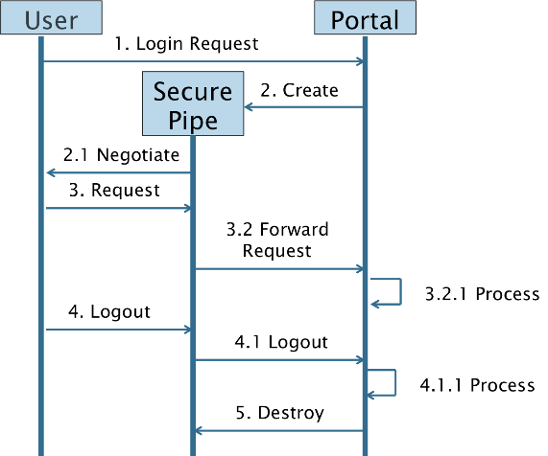
Instantiating a Security Pattern
New Component
Existing
Component
Wiring

Slide 26
Instantiating a Security Pattern
User
Portal
SN Service
Database
Login
OK
Weak Permissions
Unauthorized Access
Update Profile
Forward Update
Store Updates

Slide 27
Exercise (30 min)
Focus on the threat to confidentiality “Weak Permissions” that targets the Social Network Database
Browse the catalog to find a pattern that mitigates the threat “Weak Permissions”
Modify the social network sequence diagram to instantiate the pattern on slide 26
Send the figure (.jpeg or .png) with the modified sequence diagram to S.Ferdous@soton.ac.uk

Slide 28
Summary
A security pattern is a well understood solution to a recurring security problem
A security pattern template describes the solution and provides guidelines to implement the solution for your software architecture
Help designers with limited security expertise to build secure software architectures

Slide 29
Reading Material (1)
Catalogs of Security Patterns
M. Schumacher, E. Fernandez-Buglioni, D. Hybertson, F. Buschmann, and P. Sommerlad, Security Patterns: Integrating Security and Systems Engineering. Wiley, 2005.
E. Fernandez-Buglioni, Security Patterns in Practice: Designing Secure Architectures Using Software Patterns. Wiley, 2013.

Slide 30
Reading Material (2)
Surveys on Security Patterns
N. Yoshioka, H. Washizaki, and K. Maruyama, “A survey on security patterns,” Progress in Informatics, 2008.
A. V. Uzunov, E. B. Fernandez, and K. Falkner, “Securing distributed systems using patterns: A survey,” Computers & Security, 2012

